Slide 1
Software Lifecycle

Slide 2
Software life cycle
A software life cycle model represents all the activities and work products necessary to develop a software system.
Life cycle models enable managers and developers to deal with the complexity of developing software in the same way as an analysis model or a system design model enables developers to deal with the complexity of a software system. In the case of software systems, the reality being modeled includes phenomena such as watches, accidents, trains, sensors and buildings. In the case of software development, the reality includes phenomena such as participants, teams, activities and work products.
Many life cycle models have been published in the literature in an attempt to better understand, measure and control the development process. Life cycle models make the software development activities and their dependencies visible and manageable.

Slide 3
IEEE 1074: Standard For Developing Life Cycle Processes
IEEE Standard for Software Life Cycle Processes describes a set of activities and processes that are mandatory for the development and maintenance of software. Its goal is to establish a common framework for developing life cycle models and provide examples for typical situations.

Slide 4
Processes and Activities
Process
  A set of activities that is performed toward a specific purpose (e.g., requirements, management, delivery). The IEEE standard lists a total of 17 processes, grouped into higher levels of abstractions called process groups.
  Examples of process groups are project management, pre-development, development and post-development.
  Examples of processes in the development process group include:
    The requirements analysis process: during which developers develop system models.
    The design process: during which developers decompose the system into components.
    The implementation process: during which developers realize each component.

Slide 5
Process group | Processes
Life Cycle Modeling | Selection of a life Cycle Model
Project Management | Project Initiation Project Monitoring and Control Software quality management
Pre-development | Concept Exploration System Allocation
Development | Requirements Design Implementation
Post-development | Installation Operation and Support Maintenance Retirement
Integral | Verification and Validation Software Configuration Management Documentation Development Training
Software processes in IEEE 1074

Slide 6
Each process is composed of a set of activities.
Activity
  An activity is a task or group of sub-activities that are assigned to a team or a project participant to achieve a specific purpose. The Requirements process, for example is composed of three activities:
    Define and Develop Software Requirements: during which the functionality of the system is defined precisely.
    Define Interface Requirements: during which the interactions between the system and the user are defined precisely.
    Prioritize and Integrate Software Requirements: during which all requirements are integrated for consistency and prioritized by client preference.
Task
  Tasks consume resources (e.g., personnel, time, money) and produce a work product. During planning, activities are decomposed into project-specific tasks, are given a start and ending date, are assigned to a team or a project participant. During the project, the actual work is tracked against planned tasks and resources are reallocated to respond to problems.

Slide 7
Life Cycle Modeling
During Life Cycle Modeling, the project manager customizes the activities defined in IEEE 1074 for a specific project.
Not all projects require the same activities and the same sequencing of activities.
For example, projects that do not deal with a persistent storage do not need to execute the activity “Design Database”.
The selected life cycle model serves as input to the “Project Initiation Process”

Slide 8
Project Management ^{IEEE 1074}
During project management, the project manager initiates, monitors and controls the project throughout the software life cycle. Project management consists of three processes:
Process | Activities
Project Initiation | Map Activities to Software Life Cycle Model Allocate Project Resources Establish Project Environment Plan Project Management
Project Monitoring and Control | Analyze Risks Perform Contingency Planning Manage the Project Retain Records Implement Problem Reporting Model
Software Quality Management | Plan Software Quality Management Define Metrics Manage Software Quality Identify Quality Improvement Needs

Slide 9
Project Initiation
  Creates the infrastructure for the project.
  The task plan, schedule, budget, organization and project environment are defined.
  Project environment includes project standards, communication infrastructure, meeting and reporting procedures, development methodology and development tools.
  Most of the information generated during this process is documented in the Software Project Management Plan (SPMP).
Project Monitoring and Control
  Ensures that the project is executed according to the task plan and budget.
  If the project manager observes any deviation from the schedule, she will take corrective action such as reallocating some of the resources, changing procedures, or re-planning the schedule. The SPMP is updated to reflect any of these changes.
  This process is active throughout the life cycle
Software Quality Management
  Ensures that the system under construction meets the required quality standards (which were selected during “Project Initiation”).
  This process is executed by a separate quality management team to avoid conflicts of interest (i.e., the goal of developers is to complete the system on time, and the goal of the quality management team is to ensure that the system is not considered complete until it meets the required quality standard).
  This process is active throughout most of the life cycle.

Slide 10
Pre-Development
Management (or marketing) and a client identify an idea or a need.
This can be addressed with a new development effort (greenfield engineering), or a change to the interface of an existing system (interface engineering), or software replacement of an existing business process (reengineering).
The System Allocation Process establishes the initial system architecture and identifies hardware, software and operational requirements.
Note that the subsystem decomposition is the foundation of the communication infrastructure among the project members. The requirements, subsystem decomposition and communication infrastructure are described in the Problem Statement, which serves as an input for the development process.
Process | Activities
Concept Exploration | Identify Ideas or Needs Formulate Potential Approaches Conduct Feasibility Studies Plan System Transition (If Applicable) Refine and Finalize the Idea or Need
System Allocation | Analyze Functions Develop System Architecture Decompose System Requirements

Slide 11
Development
Consists of the processes directed toward the construction of the system.
Starts with the informal description of the requirements and defines the system requirements in terms of high-level functional requirements, producing a complete specification of the system and a prioritization of the requirements.
The design process takes the architecture produced during the System allocation process and the specification from the Requirements and produces a coherent and well organized representation of the system.
The activities “Perform Architectural Design” and “Design Interfaces” refine the subsystem decomposition. This also includes the allocation of requirements to hardware and software systems, the description of boundary conditions, the selection of off-the-shelf components, and the definition of design goals.
The detailed design of each subsystem is done during the “Perform Detailed Design” activity.
The Design Process results in the definition of design objects, their attributes and operations, and organization into packages.

Slide 12
Process | Activities
Requirements | Define and Develop Software Requirements Define Interface Requirements Prioritize and Integrate Software Requirements
Design | Perform Architectural Design Design Database (if Applicable) Design Interfaces Select or Develop Algorithms (if Applicable) Perform Detailed Design
Implementation | Create Test Data Create Source Generate Object Code Create Operating Documentation Plan Integration Perform Integration

Slide 13
Post-Development
Consists of the installation, maintenance, operation and support, and retirement processes.
During installation, the system software is distributed and installed at the client site. The installation culminates with the client acceptance test according to criteria defined in the Project Agreement.
Operation and Support is concerned with user training and operation of the system.
Maintenance is concerned with the resolution of software errors, faults and failures after the delivery of the system. It requires a ramping of the software life cycle processes and activities into a new project.
Retirement removes an existing system, terminating its operations or support; this occurs when the system is upgraded or replaced by a new system. To ensure a smooth transition between the two systems, both systems are often run in parallel.

Slide 14
Process | Activities
Installation | Plan Installation Distribution of Software Installation of Software Accept Software in Operational Environment
Operation and Support | Operate the System Provide Technical Assistance and Consulting Maintain Support Request Log
Maintenance | Reapply Software Life Cycle
Retirement | Notify Users Conduct Parallel Operations (If Applicable) Retire System

Slide 15
Integral Processes (Cross-Development)
Several processes take place during the complete duration of the project. These are called integral processes (also called cross-development processes) and include: Validation and Verification, Software Configuration Management, Documentation Development and Training.
Verification and Validation – Verification tasks focus on showing that the system model comply with the specification. This includes reviews, audits and inspections. Validation tasks ensure that that the system addresses the client’s needs and includes system testing, beta testing, and client acceptance testing. Verification and Validation occur throughout the life cycle with the intent of detecting anomalies as early as possible.

Slide 16
Configuration Management Process – focuses on the tracking and control of changes to work products. Items under configuration management include the source code for the system, all development models, the software project management plan, and all documents visible to the project participants.
Documentation Process – deals with the work products (excluding code), documenting the results produced by other processes. Document templates are selected during this activity. The IEEE 1074 standard, however, does not prescribe any specific document or template.

Slide 17
Integral Processes (Cross-Development)
Process | Activities
Verification and Validation | Plan Verification and Validation Execute Verification and Validation Tasks Collect and Analyze Metric Data Plan Testing Develop Test Requirements Execute the Tests
Software Configuration Management | Plan Configuration Management Development Configuration Identification Perform Configuration Control Perform Status Accounting
Documentation Development | Plan Documentation Implement Documentation Produce and Distribute Documentation
Training | Plan the Training Programme Develop Training Materials Validate the Training Programme Implement the Training Programme

Slide 18
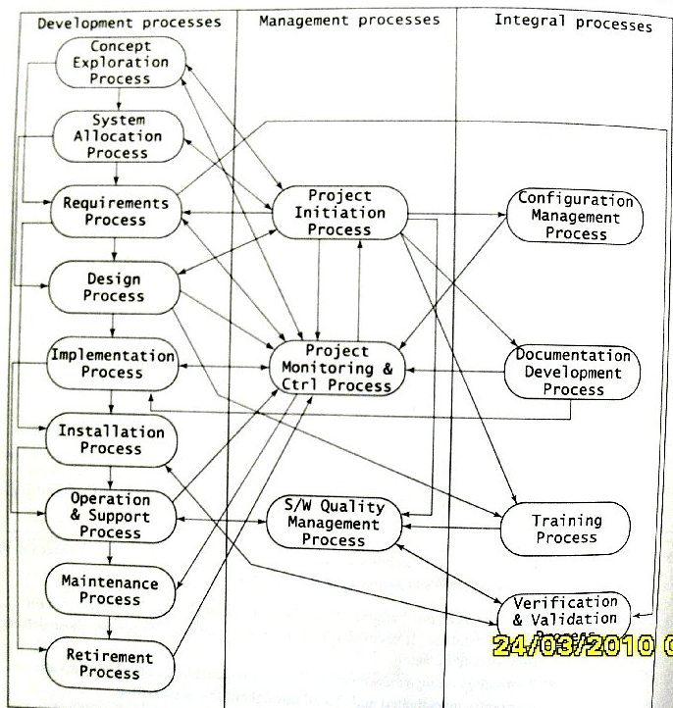

Slide 19
Life Cycle Models
Sequential Activity Centered Models
  Waterfall model
  V-model
Iterative Activity Centered Models
  Spiral model
  Unified Software Development Process
Entity-Centered Models

Slide 20
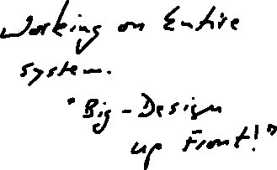

Waterfall Model
Project Initiation Process
Concept Exploration Process
System Exploration Process
Requirements Process
Design Process
Implementation Process
Verification and Validation Process
Installation Process
Operation and Support Process

Slide 21
V-model
Operation
System Requirements Analysis
Software Requirements Elicitation
Client Acceptance
Requirements Analysis
System Integration and Test
Preliminary Design
Component Integration and Test
Detailed Design
Unit Test
Implementation

Slide 22
V-model
A variation of the waterfall that makes explicit the dependency between the development activities and the verification activities.
The difference with the waterfall model is that the V-model depicts the level of abstraction. All activities from requirements to implementation focus on building an increasingly detailed representation of the system, whereas all activities from implementation to operation focus on validating the system.

Slide 23
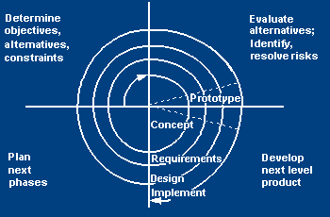
Spiral Model – Barry Boehm

Slide 24
Spiral Model
An activity-centered life cycle model that was devised the sources of weakness in the waterfall model, in particular, to accommodate infrequent change during software development.
It is based on the same activities as the waterfall model, but adds risk management, reuse and prototyping to each activity. These extended activities are called cycles or rounds.
The model focuses on addressing risks incrementally, in order of priority.

Slide 25
Each round follows the waterfall model and includes the following activities:
  Determine objectives
  Specify constraints
  Generate alternatives
  Identify risks
  Resolve risks
  Develop and verify next level product
  Plan

Slide 26
Unified Software Development Process
Exercise for student. (MUST be known).
Compare and contrast the following process models:
  Unified Software Process
  Scrum
  Extreme Programming
  Test Driven Design

Slide 27
Unified Software
Development Process
Developed by the team that created UML
Embodies best practice in system development
Adopts an iterative approach with four main phases
Different tasks are captured in a series of workflows

Slide 28
Best Practice
Iterative and incremental development
Component-based development
Requirements-driven development
Configurability
Architecture-centrism
Visual modelling techniques

Slide 29
Four Phases
Inception
Elaboration
Construction
Transition

Slide 30
Phases, Workflows and Iterations
Within each phase activities are grouped into workflows
The balance of effort spent in each workflow varies from phase to phase
Within phases there may be more than one iteration

Slide 31
Project Phases
Inception
Elaboration
Construction
Transition
1
2
3
4
5
6
7
8
Iterations within each phase
Requirements
Analysis
Design
Implementation
Test
Workflows
Size of square relative to time spent on workflowh
© Bennett, McRobb and Farmer 2005

Slide 32
Difference from
Waterfall Life Cycle
In a waterfall life cycle project the phases and the workflows are linked together
In the Requirements phase, only Requirements workflow activities are carried out
All Requirements activity should be completed before work starts on Analysis
In an iterative life cycle project it is recognised that some Requirements work will be happening alongside Analysis work

Slide 33
Requirements
Design
Test
Analysis
Implementation
Requirements
Analysis
Design
Implementation
Test

Slide 34
IEEE-12207 Standard
Supercedes 1074
Sections
  Section 1 - Scope and field of application;
  Section 2 - Normative references;
  Section 3 - Definitions;
  Section 4 - Top-level overview of the life cycle processes;
  Section 5 - Activities and tasks of the five primary processes;
  Section 6 - Activities and tasks of the eight supporting processes;
  Section 7 - Activities and tasks of the four organizational processes;
  Annex A - Activities and tasks for tailoring (or adapting) the standard for a software project;
  Annex B - Brief guidance on tailoring the standard;
  Annex C - General information on the processes, organizations, and their relationships;
  Annex D - Bibliography.

Slide 35
You can visit the folllowing site for Dr Winston Royce’s original paper on the waterfall model, although he did not call it a waterfall model. http://www.cs.umd.edu/class/spring2003/cmsc838p/Process/waterfall.pdf
The Scrum guide can be found at the following site.
https://www.scrum.org/Portals/0/Documents/Scrum%20Guides/Scrum_Guide.pdf

